Slide 1
Decomposition model
ESTP Training

Slide 2
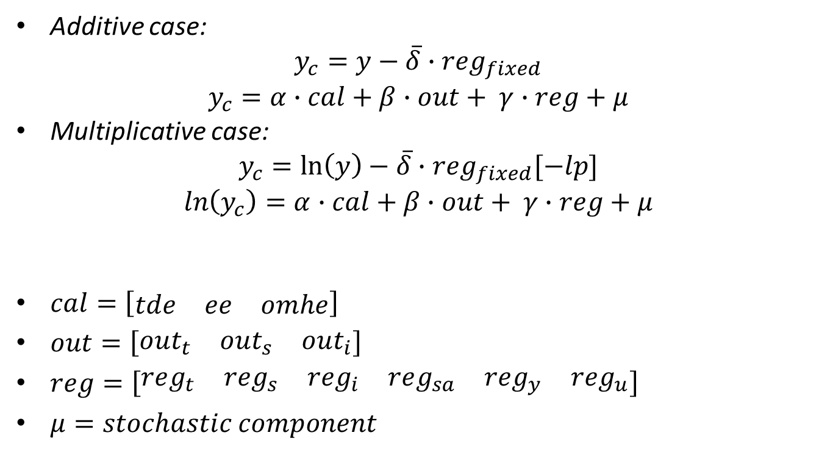
Regression model
Additive case:
$$y_{c}=y−\overline{δ}∙{reg}_{fixed}$$
$$y_{c}=α∙cal+β∙out+ γ∙reg+μ$$
Multiplicative case:
$$y_{c}=\ln\left(y\right)−\overline{δ}∙{reg}_{fixed}[−lp]$$
$$\ln\left(y_{c}\right)=α∙cal+β∙out+ γ∙reg+μ$$
$cal=\left[\begin{matrix}tde & ee & omhe\end{matrix}\right]$
$out=\left[\begin{matrix}out_{t} & out_{s} & out_{i}\end{matrix}\right]$
$reg=\left[\begin{matrix}reg_{t} & reg_{s} & reg_{i} & reg_{sa} & reg_{y} & reg_{u}\end{matrix}\right]$
$μ=stochastic component$

Slide 3
Handling of the regression variables
Code | Description | T | S | I | SA
tde | Trading days (default, holidays, user-defined) |  | x
ee | Easter |  | x
omhe | Other moving holidays (TODO: Ramadan…) |  | x
AO | Additive outlier |  |  | x | x
TC | Transitory change |  |  | x | x
LS | Level shift | x |  |  | x
SO, SLS | Seasonal outlier / seasonal level shift |  | x
Reg_i | Regression variables allocated to irregular, IV (p) |  |  | x | x
Reg_t | Regression variables allocated to trend, ramps, IV (p) | x |  |  | x
Reg_s | Regression variables allocated to seasonal, IV (p)
Reg_sa | Regression variables allocated to seas. adjusted |  |  |  | x
Reg_y | Regression variables removed before decomposition
Reg_u | Regression variables unallocated to a component | p | p | p | p
p stands for partially

Slide 4
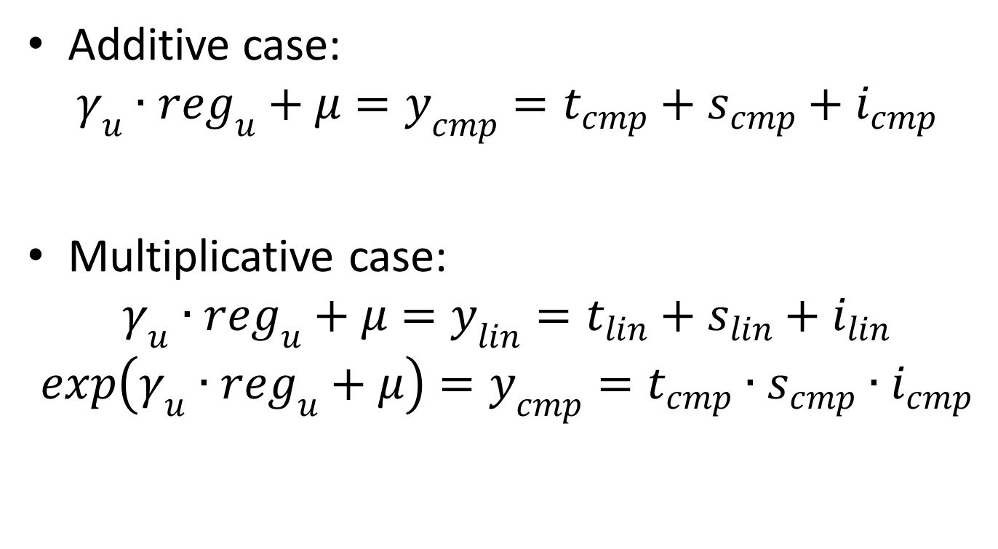
Decomposition
Additive case:
$$γ_{u}∙reg_{u}+μ=y_{cmp}=t_{cmp}+s_{cmp}+i_{cmp}$$
Multiplicative case:
$$γ_{u}∙reg_{u}+μ=y_{lin}=t_{lin}+s_{lin}+i_{lin}$$
$$exp\left(γ_{u}∙reg_{u}+μ\right)=y_{cmp}=t_{cmp}∙s_{cmp}∙i_{cmp}$$

Slide 5
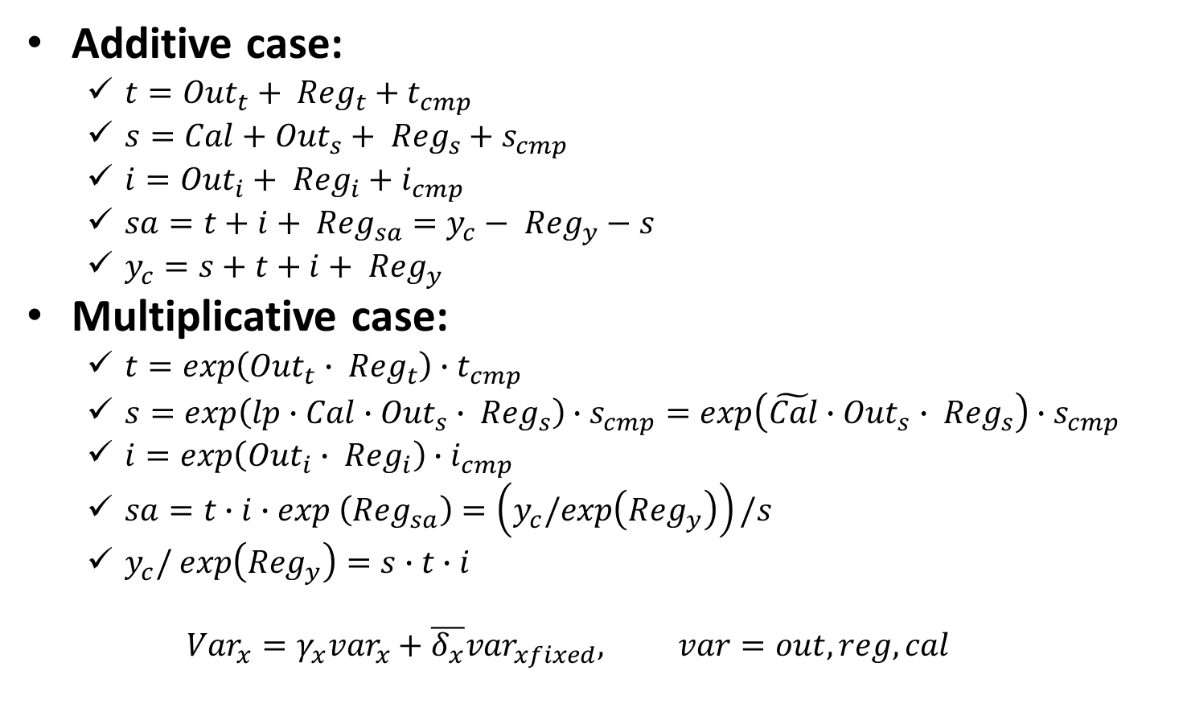
Final decomposition
Additive case:
$t={Out}_{t}+ {Reg}_{t}+t_{cmp}$
$s=Cal+{Out}_{s}+ {Reg}_{s}+s_{cmp}$
$i={Out}_{i}+ {Reg}_{i}+i_{cmp}$
$sa=t+i+ {Reg}_{sa}=y_{c}− {Reg}_{y}−s$
$y_{c}=s+t+i+ {Reg}_{y}$
Multiplicative case:
$t=exp\left({Out}_{t}∙ {Reg}_{t}\right)∙t_{cmp}$
$s=exp\left(lp∙Cal∙{Out}_{s}∙ {Reg}_{s}\right)∙s_{cmp}=exp\left(\tilde{Cal}∙{Out}_{s}∙ {Reg}_{s}\right)∙s_{cmp}$
$i=exp\left({Out}_{i}∙ {Reg}_{i}\right)∙i_{cmp}$
$sa=t∙i∙exp \left({Reg}_{sa}\right)=\left(y_{c}/exp\left({Reg}_{y}\right)\right)/s$
$y_{c}/ exp\left({Reg}_{y}\right)=s∙t∙i$
$${Var}_{x}=γ_{x}{var}_{x}+{\overline{δ_{x}}var}_{xfixed}, var=out,reg, cal$$

Slide 6
SA_lin
LS
reg_trend, ramps
T_lin
T
SA
AO + TC
reg_i
I_lin
I
TD + Hol
SO [+ SLS]
reg_s
S_lin
S
Deterministic effects
Stochastic components

